Slide 1
Suryaa D
Final Project
3/21/2024 Annual Review

Slide 2
PROJECT TITLE
CIFAR-10 Image Classification with CNN
DEPARTMENT OF COMPUTERSCIENCE AND ENGINEERING
Presented By: Suryaa D
Register Number: 813821104106
3/21/2024 Annual Review

Slide 3


AGENDA
The agenda for the "Deep Learning CIFAR-10 Image Classifier with TensorFlow" project includes introducing the CIFAR-10 dataset and its significance in image classification tasks.
We'll discuss the implementation of a convolutional neural network (CNN) architecture using TensorFlow and Keras, covering model training, evaluation, and visualization of results.
Additionally, we'll explore the practical applications of the trained model, such as image recognition and transfer learning.
Furthermore, we'll showcase an interactive interface for users to classify their own images, enhancing engagement and understanding of the project's utility.
3/21/2024 Annual Review

Slide 4

PROBLEM STATEMENT
Develop a robust deep learning-based image classification system using the CIFAR-10 dataset. The system should accurately classify 32x32 color images into one of ten predefined classes. The goal is to implement and optimize a convolutional neural network (CNN) architecture using TensorFlow and Keras to achieve high accuracy in image classification. Additionally, the project aims to provide users with an intuitive interface for real-time image classification, demonstrating the practical applicability and usability of the developed system
3/21/2024 Annual Review

Slide 5

PROJECT OVERVIEW
The project focuses on creating a deep learning-based image classifier using the CIFAR-10 dataset.
It involves several key components: Data loading and preprocessing, model architecture design using convolutional neural networks (CNNs), model training and evaluation, and visualization of results. The primary goal is to achieve high accuracy in classifying 32x32 color images into ten predefined classes.
Additionally, the project aims to provide users with an interactive interface for real-time image classification, enhancing user engagement and demonstrating the practical utility of the developed system.
3/21/2024 Annual Review

Slide 6

WHO ARE THE END USERS?
Researchers and Developers: Individuals working in the field of machine learning and deep learning who seek to understand and experiment with image classification algorithms using real-world datasets like CIFAR-10.
Students and Educators: Students studying machine learning or deep learning concepts as part of their academic curriculum, as well as educators who use such projects to teach these concepts in courses related to computer science, artificial intelligence, or data science.
Software Engineers and Data Scientists: Professionals interested in exploring image classification techniques and integrating them into their applications or projects, such as those working in computer vision, image processing, or related domains.
General Public: Enthusiasts who are curious about deep learning and want to explore its capabilities, as well as individuals interested in using the provided image classifier for personal projects or applications.
3/21/2024 Annual Review

Slide 7

YOUR SOLUTION AND ITS VALUE PROPOSITION
The solution program consists of two sections:
The first section trains a convolutional neural network (CNN) model on the CIFAR-10 dataset, achieving a test accuracy of around 70-80% after 10 epochs. The model architecture includes convolutional layers followed by max-pooling layers and dense layers.
The second section visualizes sample images from the CIFAR-10 dataset along with their corresponding labels. This comprehensive solution demonstrates both training and evaluation of a CNN model for image classification, as well as data visualization.
3/21/2024 Annual Review

Slide 8

THE WOW IN YOUR SOLUTION
The "wow" factor of this project lies in its real-time image classification capability coupled with an interactive interface. By integrating a feature that allows users to upload and classify their own images, the project transcends mere demonstration to become an engaging and practical tool.
This wow factor not only enhances user experience but also showcases the versatility and applicability of the developed image classifier beyond the provided CIFAR-10 dataset.
Users can witness firsthand how the deep learning model can analyze and classify images, making the abstract concept of machine learning tangible and exciting.
3/21/2024 Annual Review

Slide 9
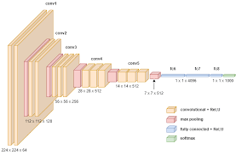
MODELLING:
Convolutional Neural Network (CNN)
The Convolutional Neural Network (CNN) model employed in this project for CIFAR-10 image classification consists of multiple convolutional layers followed by max-pooling layers, enabling the extraction of hierarchical features from input images.
The model architecture includes convolutional filters to detect patterns and dense layers for classification, achieving high accuracy on image recognition tasks.
3/21/2024 Annual Review

Slide 10
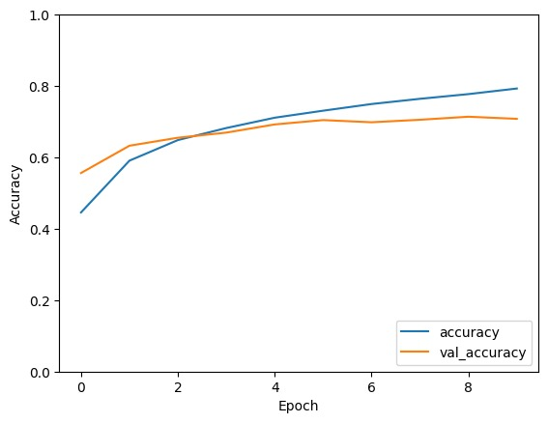
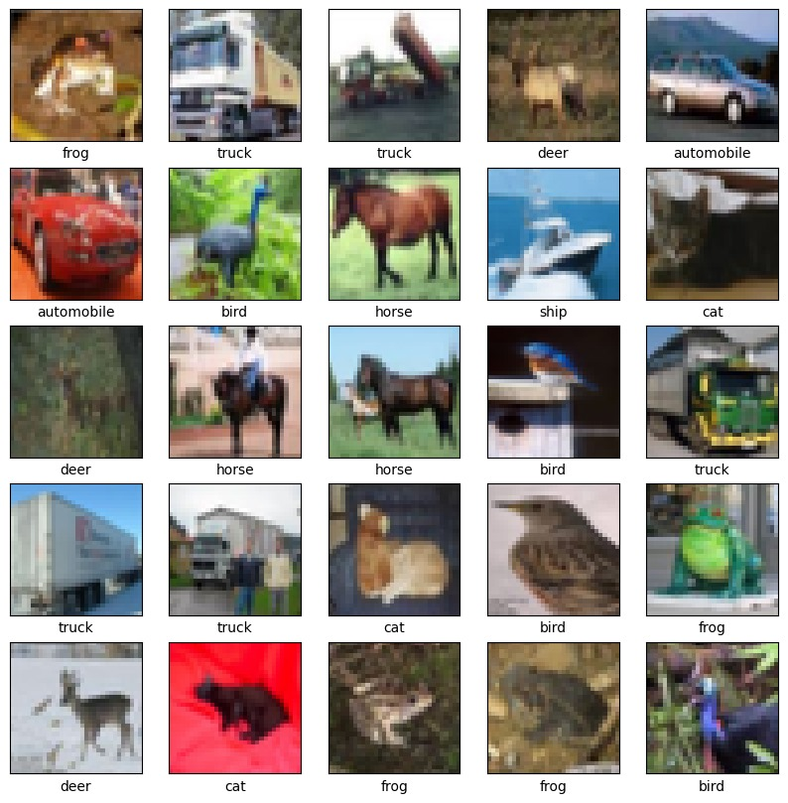
RESULTS
Demo Link
3/21/2024 Annual Review

Slide 11
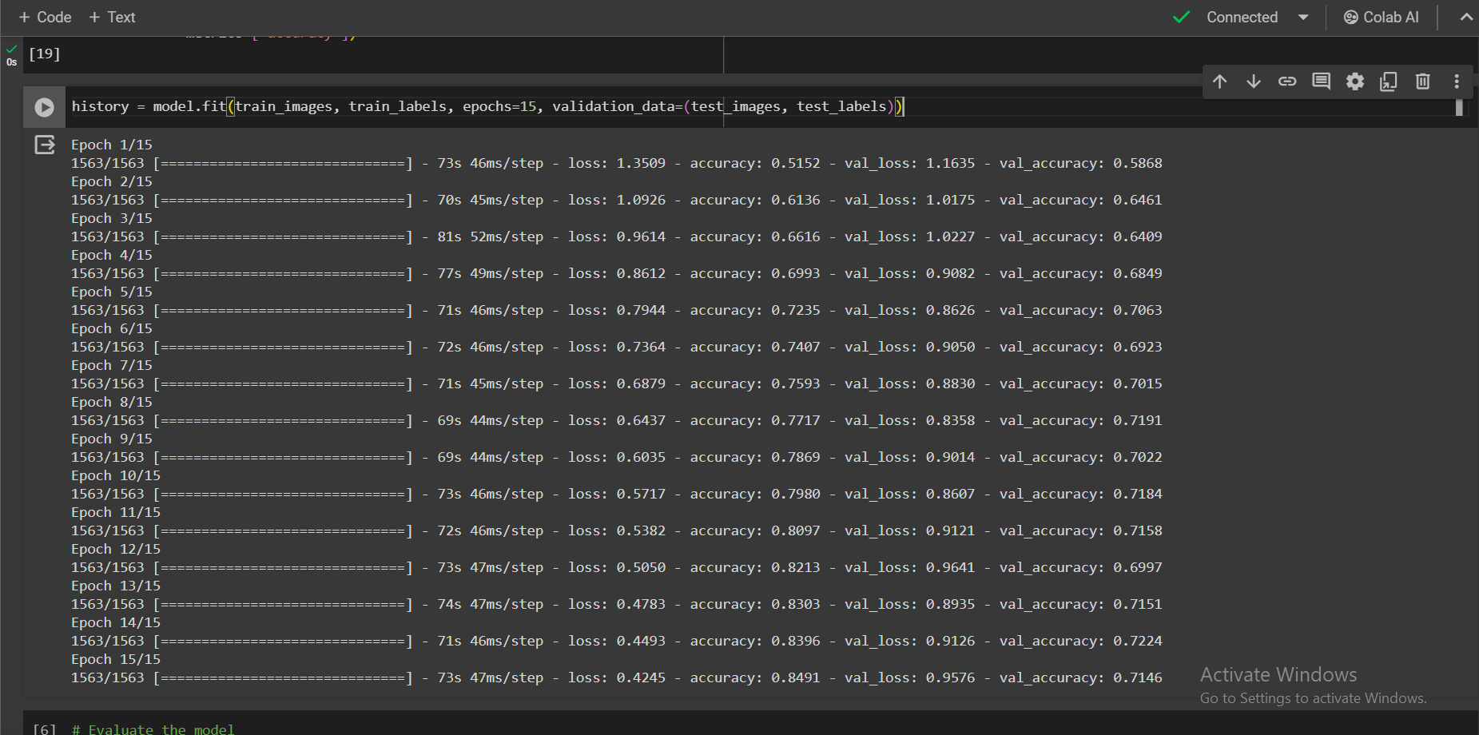
RESULTS
Accuracy:

Slide 12
Thank You
https://github.com/SuryaaVijayD/TNSDC_AI-Project.git
3/21/2024 Annual Review

